Slide 1

Analysis of Sales Pattern and facilitate organization to reduce the Cash Flow Mismatch
A Presentation of the BDM Capstone Project
IITM Online BS Degree Program,
Indian Institute of Technology, Madras, Chennai
Tamil Nadu, India, 600036
Presented by
Name: CHELAKARRI ANANTHA SAI SRIKAR
Roll number: 21f1004284

Slide 2

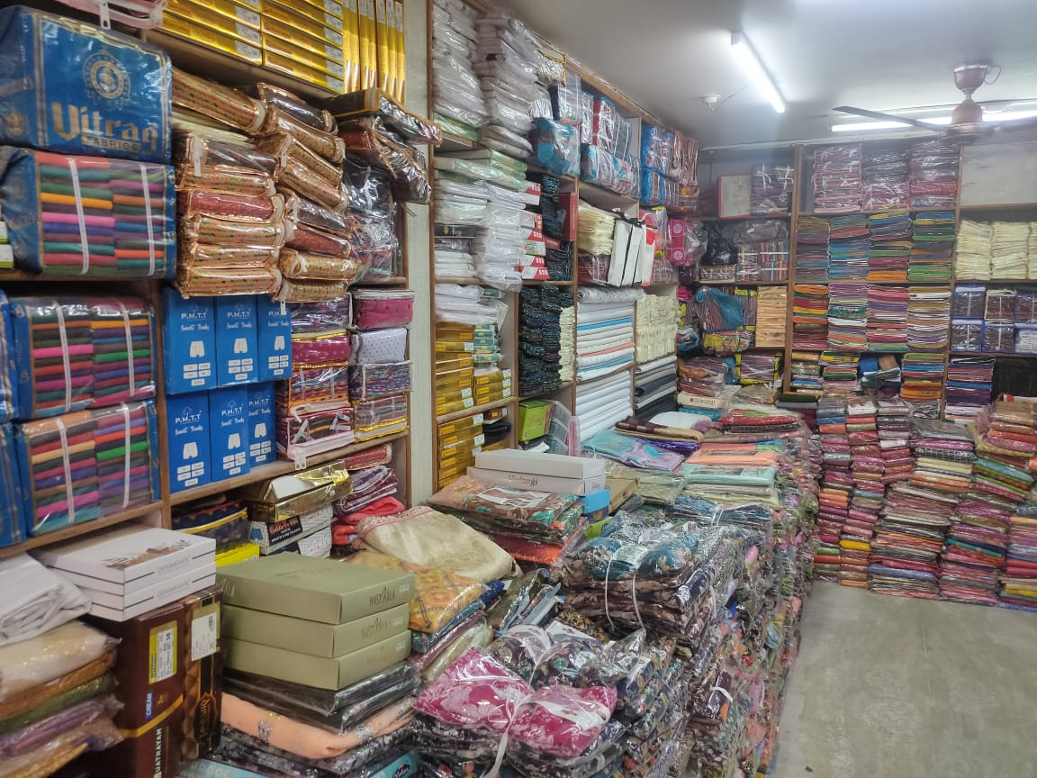

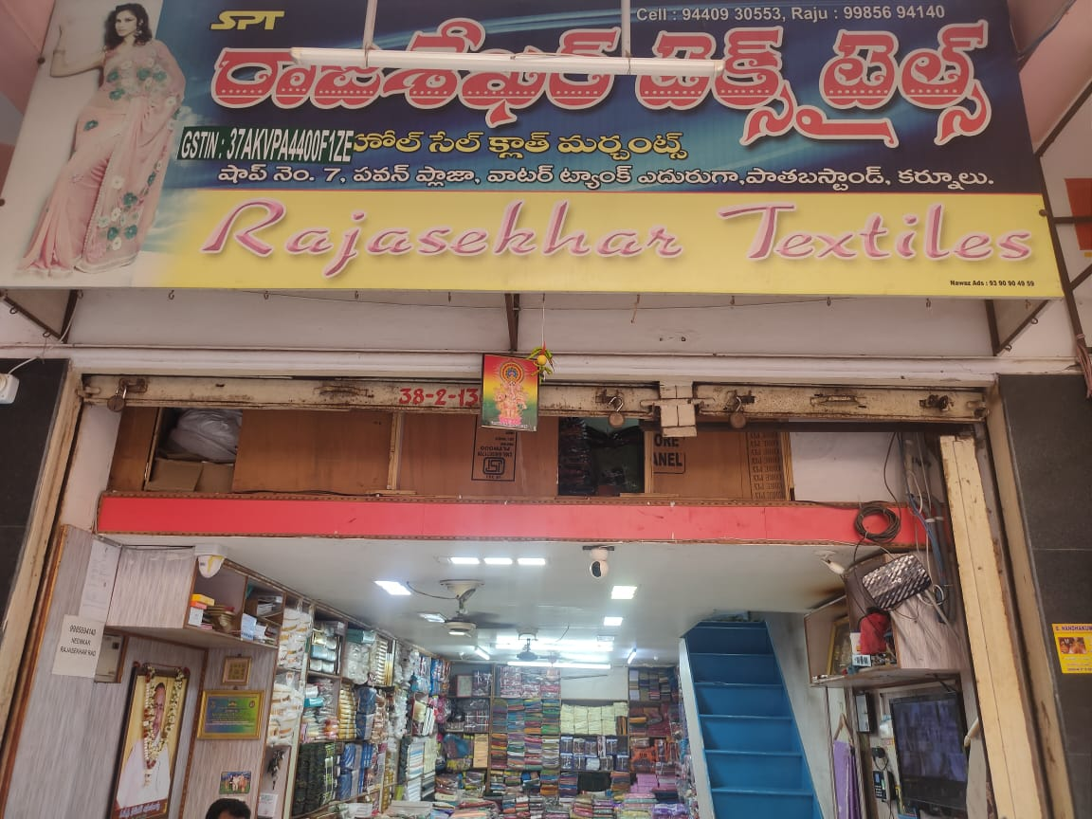
About Project
The interior and exterior of the organization are depicted in Figures 1.1 and 1.2, respectively.
The Business Data Management Capstone Project features:
Identifying an Organization and inquiring about their background and business challenges.
Identifying the background of problems and collecting relevant data from the organization.
Refining & Modifying the data and analysing it through various methods.
Interpreting the analysis and summarizing the relevant information needed.
Offering the organization recommendations to enhance their business operations.
Fig: 1.1
About Organization
The Organization that I am working with is a medium-sized textile shop in Kurnool, Andhra Pradesh. Some information and highlights of this B2B business, Rajashekar Textiles:
This for-profit textile shop which is a distribution centre for various retail shops is maintained by the owner Rajashekar.
The shop gets its products from Surat, Kolkata, Bangalore, Varanasi and has a staff of about 15 members.
With nearly three decades of experience in the textile business, Rajashekar Textiles consistently offer their customers the highest quality products available.
Fig: 1.2

Slide 3

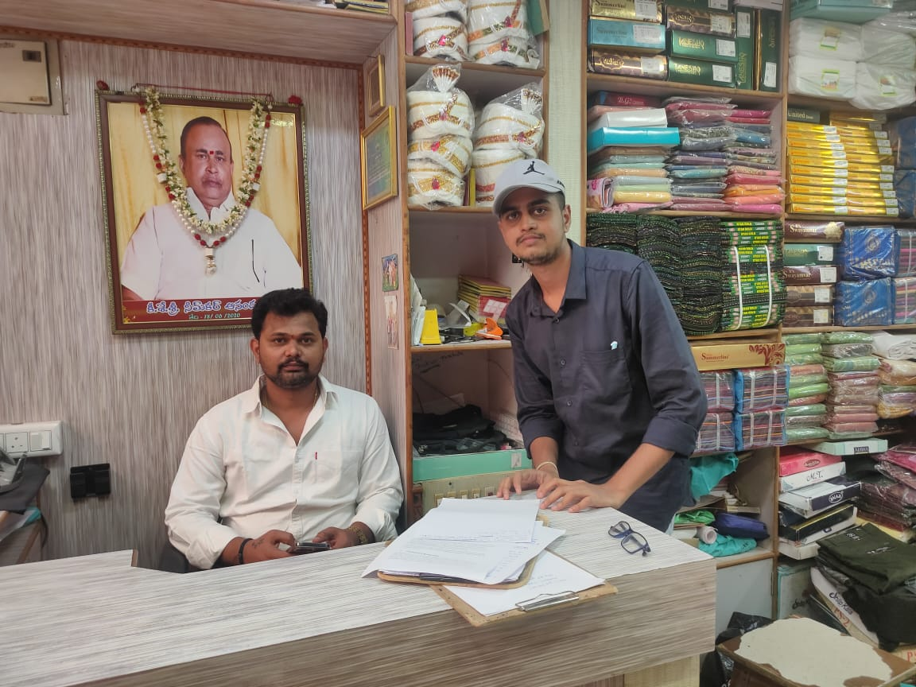

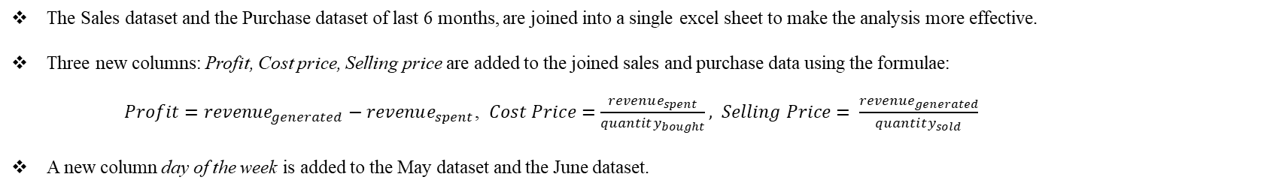
Problem Statements
Following discussions with the owner Rajashekar, several key issues have been identified that need to be addressed to drive the organization’s growth, and the relevant data is collected.
Improve the Inventory Management & understand customer needs to minimize excess inventory and streamline purchasing strategies.
Align cash inflows from customers with outflows to suppliers to mitigate Cash Flow Mismatch and enhance liquidity management.
Enhance labour management, manage employee leave and maintain workforce satisfaction.
About Data
The organization has provided the following datasets:
Sales Data with item name, quantity sold, revenue generated as its features. (from Jan, 2024 to Jun, 2024)
Purchase Data with item name, quantity bought, revenue spent as its features. (from Jan, 2024 to Jun, 2024)
May Data & June Data with date, quantity sold, revenue generated as their features. (May and June of 2024)
To investigate each issue, the data would go through various analysis processes, each used for a specific purpose. Before that, a few modifications are made to the data to make it ready for the analysis.
Owner of the organization and Me.
Note: Sales & Purchase datasets don’t have specific dates or months. The columns “revenue” and “quantity”
represent the total of them in last 6 months for each item.
Data Refinement
The Sales dataset and the Purchase dataset of last 6 months, are joined into a single excel sheet to make the analysis more effective.
Three new columns: Profit, Cost price, Selling price are added to the joined sales and purchase data using the formulae:
$Profit=revenue_{generated}−revenue_{spent}$, $Cost Price=\frac{revenue_{spent}}{quantity_{bought}}, Selling Price= \frac{revenue_{generated}}{quantity_{sold}}$
A new column day of the week is added to the May dataset and the June dataset.

Slide 4


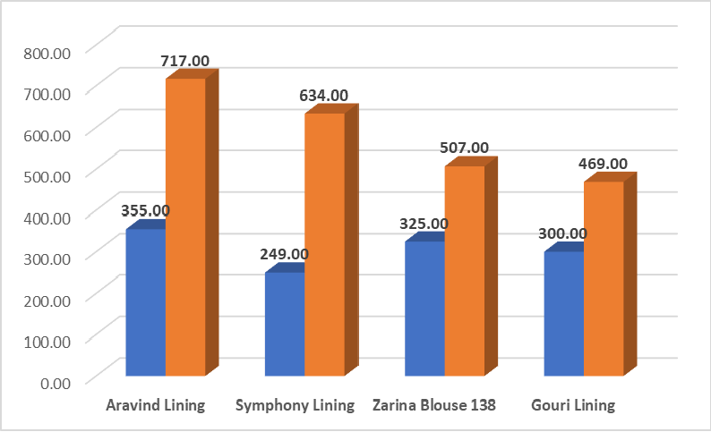
Analysis Methods
Analysis of joined sales and purchase data using Clustered Column Charts.
Finding trends in May & June data using scatter plots.
Identifying relationships between features in joined sales and purchase data using Correlation Table (Heatmap).
Uncovering the similarity and differences between SKUs using Cluster Analysis.
Evaluating the profitability of different items and the organization’s ability to generate profit using Profitability Ratios.
The shop’s cash flow and labour problems are connected to the first problem, which is management of items. Reducing overstocking of items and having the stock of top items, frees up the cash that is tied up so the cash flow can be reduced to some extent and the labours salaries also can be well managed.
All the Analysis Graphs are presented in the following link : Link to the Graphs
Clustered Column Charts
Two Clustered Column Charts are plotted in excel for the joined sales and purchase dataset to make clear comparisons across multiple categories. Fig 4.1 and Fig 4.2 represent the clustered column charts plotted between quantity sold, quantity bought and revenue generated, revenue spent respectively for different items.
Results & Findings from the Fig 4.1 :
The shop overstocked low-priced items like Aravind Lining, Symphony Lining, Zarina Blouse 138, and Gouri Lining, which have significantly lower cost prices than the average of ₹228.58. This statement is clearly depicted through Fig 5.1.
The shop also overstocked higher-priced items like Flora Fairy, Digital 3K Loose, and Ice Lady Email whose cost prices are 202, 166 and 143 respectively, which is riskier and more financially burdensome than overstocking lower-priced items. This statement is clearly depicted through Fig 5.2.
Additionally, the shift in maxima between quantity sold and quantity bought may occur due to Timing Differences. If the quantity bought peaks before the quantity sold, it could indicate that the shop is purchasing inventory in anticipation of the future demand.
Fig 5.1

Slide 5
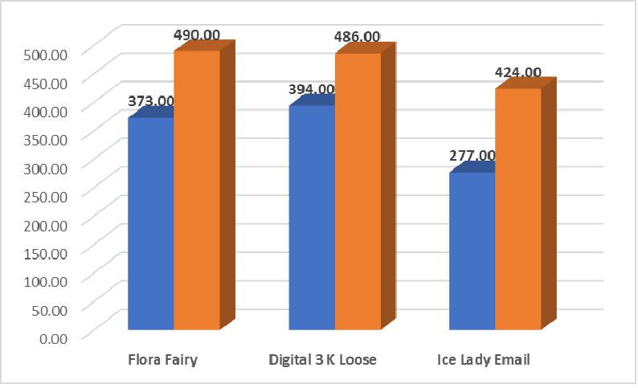
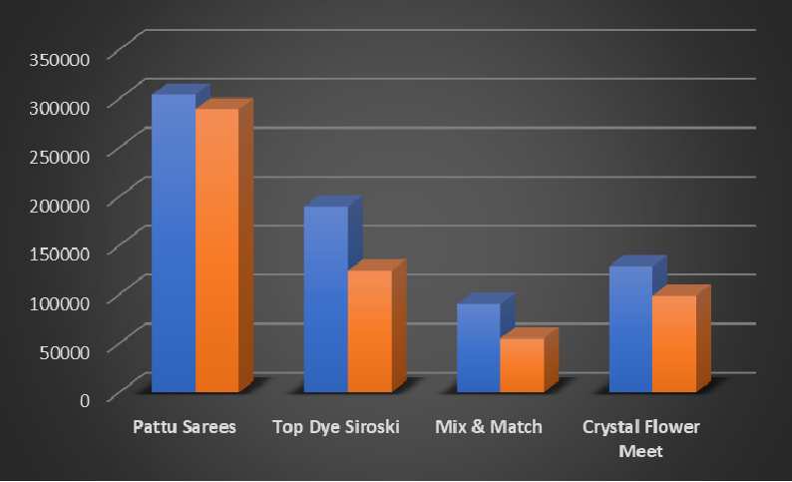

Additionally, the shift in maxima for these items, may occur because the peaks in revenue generated and spent do not align perfectly across the lifecycle stages of a product. For example, the maximum expense might occur during the growth phase when the company is heavily investing in scaling production and marketing. However, the maximum revenue might not occur until the maturity stage when sales have fully ramped up.
Fig 5.2
Fig 5.3
Results & Findings from the Fig: 4.2 :
Pattu Sarees is the most popular item in terms of revenue, but Top Dye Siroski and Mix & Match are the most profitable.
Top Dye Siroski, Mix & Match, and Crystal Flower Meet have profits far exceeding the average of ₹8787.35, with profits of ₹65601.36, ₹35000.07, and ₹30012.27 respectively.
When both the figures 4.1, 4.2 are looked at side by side, the most profitable items, like Top Dye Siroski, Mix & Match, Barfi Silk Parvati, Crystal Flower Meet, Dollar Viransh, and Docomo Suryakiran, are all at risk of stockouts.
The statements here are clearly depicted through Fig 5.3.
Scatter Plots
The other two datasets: May data and June data are taken and scatter plots are plotted for the datasets using pivot tables and insert chart features in excel, to identify the sales trends of products over time. This is specifically done to identify the business’s activity over days.
The figure 6.1,6.2 are scatterplots between day of the week and shop’s activity (blue line: quantities sold, red dotted line: revenue generated) for only May & May and June respectively. While blue line is negligible in the context of the graph, the area of interest is revenue generated.

Slide 6

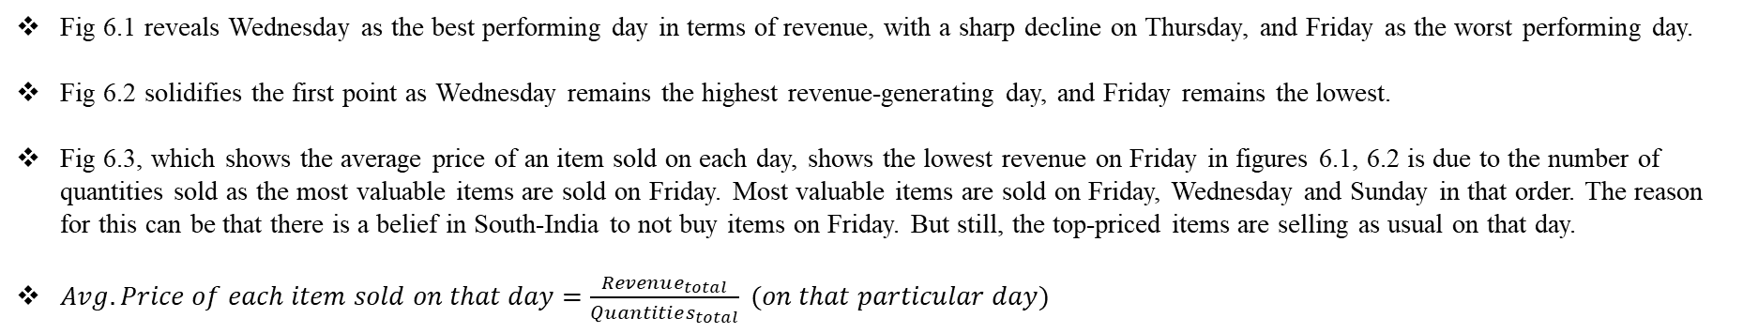
Results & Findings from the figures 6.1, 6.2, 6.3
Fig 6.1 reveals Wednesday as the best performing day in terms of revenue, with a sharp decline on Thursday, and Friday as the worst performing day.
Fig 6.2 solidifies the first point as Wednesday remains the highest revenue-generating day, and Friday remains the lowest.
Fig 6.3, which shows the average price of an item sold on each day, shows the lowest revenue on Friday in figures 6.1, 6.2 is due to the number of quantities sold as the most valuable items are sold on Friday. Most valuable items are sold on Friday, Wednesday and Sunday in that order. The reason for this can be that there is a belief in South-India to not buy items on Friday. But still, the top-priced items are selling as usual on that day.
$Avg. Price of each item sold on that day=\frac{Revenue_{total}}{Quantities_{total}} (on that particular day)$
Rest of the analysis methods are all done on the joined sales and purchase dataset
Correlation table (Heatmap)
The cells of each column in the dataset (except the column “item name”) are formatted as “Number” in excel and the dataset is imported to Google Colab.
A Correlation table is made to find the relationship between the variables: quantity sold, quantity bought, revenue generated, revenue spent and profit. This is done by converting the dataset into a pandas dataframe and plotting the correlation table as a heatmap.
Results & Findings from the Fig 7.1
There is a correlation of 0.98 between revenue generated and spent, which is extremely high, indicating that these two almost move in tandem. This strong correlation suggests that profit margins might be sensitive to changes in either spending or costs. If costs were to rise without a corresponding increase in revenue (or if increasing spending didn’t lead to higher revenue), profit margins could decrease.
There is a strong positive correlation (0.77) between quantity sold and quantity bought. If the shop’s sales are heavily dependent on consistently buying more inventory, it could indicate that the shop is in a cycle where increasing sales require continuous investment in stock. This might lead to cash flow issues if the shop needs high level of purchasing to maintain their sales.

Slide 7

Cluster Analysis
For the clustering, the sales & purchase data are taken separately again to maintain a focused approach and avoiding the influence of other factors.
As the algorithms that rely on distance metrics perform better when the data is on similar scale, standardization is applied to both the datasets.
To find similar products in terms of sales and purchases, we identify clusters in these datasets using hierarchical clustering and visually represent them using Dendrograms. Everything is done in Google Colab.
While Fig 7.2 represents the dendrogram of sales data, Fig 8.1 represents the dendrogram of purchase data for different items.
Results & Findings from the Fig 7.2
Jiya Karuna and Mix & Match are extremely similar items in terms of sales and Digital 3K Loose is also very similar to those items.
While Pattu Sarees is the most uniquely selling item in the shop, Top Dye Siroski, Barfi Silk Parvati are not far behind. Interestingly, these are the top items in the shop in terms of revenue and profits.
Results & Findings from the Fig 8.1
Kaveri 1mt Lining, Gouri 1mt Lining from orange cluster and Aravind Lining, Symphony Lining from Green cluster may imply that there is some sort of clear buying patterns for low-priced items like blouses and linings.
In the purple cluster, there is a cluster in Mix & Match, Sarika Box, Ice Lady Panisha, Jiya Karuna and Ice Lady SUNIL, whose purchase patterns are very similar.
Note: In hierarchical clustering, items that form clusters earlier (at lowest Euclidean distances) are more similar to each other compared to those that merge later. So, the clusters of interest are the lowest ones in the graph which are formed at the earliest.

Slide 8

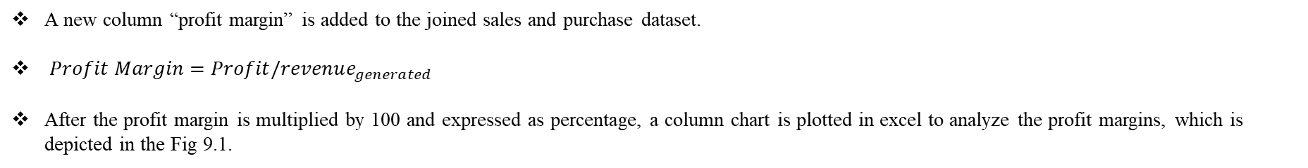
Profitability Ratios
A new column “profit margin” is added to the joined sales and purchase dataset.
$Profit Margin=Profit/revenue_{generated}$
After the profit margin is multiplied by 100 and expressed as percentage, a column chart is plotted in excel to analyze the profit margins, which is depicted in the Fig 9.1.
Items to consider from the graph 9.1:
Mix & Match: This item has the highest profit margin at 38.84% and strong sales, generating ₹90,122 in revenue, well above the ₹67,619 average. Its combination of high profit and revenue makes it a key contributor to overall profitability.
Pretti Kote: Despite being second in profit margin (37.32%), this item generates only ₹8,863 in revenue, well below the average. Its high profit margin, driven by low revenue, suggests it's a well-maintained, high-profit item within the lower-priced category.
Top Dye Siroski: This item, priced at ₹778 (well above the average of ₹279), is highly popular, with 244 sold versus 181 bought, risking a stockout. Generating ₹1,89,927 in revenue, and high profits along with it, the shop should invest in this item and maintain ample stock to maximize profits and avoid missed sales.
Pattu Sarees: This item generates significant revenue but has a low profit margin (4.93%), which can impact overall profitability. Its minimal profit may suggest high costs, and any increase in costs could further affect the shop's profitability.
Additionally, Ice Lady Email and Sarika Box whose revenues are close to the average revenue, have zero profit margins. As they contribute to the overall sales volume but they do not contribute positively to profitability, these items can pose problems for the business.
Low priced items like Symphony and Gouri Linings have negative profit margins. Though these are low priced items, it is important to consider the negative profit margin as it will be a financial loss for the business.

Slide 9


Interpretation of Results
From the first analysis process, clustered column chart it is evident that shop overstocks low-priced items which is further confirmed by the dendrogram, where it showed a similar purchase patterns of low priced items.
If the shop wants to grant a leave to their labours, they most probably should grant on Friday, leaving some top workers behind to sell highly priced items on that day. If the shop wants to sell top priced items, they can opt for Friday, Wednesday, Sunday and if the shop wants to offer discounts, they can opt for Wednesday.
As there is a correlation of 0.98 between revenue generated and spent, the shop should carefully manage their spending and costs to attain profits. Cash Flow is one of the major problems of the shop and shop can reduce it to some extent by avoiding overstocking and freeing up that tied up cash.
As Jiya Karuna and Mix & Match are both similar in terms of selling and purchasing, shop can maintain both of these items together.
Shop should focus on maintaining enough stocks of Mix & Match, Top Dye Siroski. As Pattu Sarees generates most revenue with a low profit margin. If phasing this item out is not easy, the shop should review its pricing and reduce the costs related to this item if they want to make most out of its revenue. Ice Lady Email, Sarika Box, Symphony Lining and Gouri Lining can be considered for phasing out.
Recommendations
Reduce overstocking of low-priced items that are unprofitable and instead focus on maintaining adequate stock levels of high margin items like Top Dye Siroski and Mix & Match to avoid stockouts and maximize profitability.
Consider granting leave to labours primarily on Fridays if they request it, keeping the key staff to handle sales of high-priced items on that day. Additionally, consider utilizing Fridays for gathering feedback from the staff, while focusing on boosting sales of top-performing items on Wednesdays and Sundays.
Ensure the revenue generated grows faster than costs and spending to increase profitability. To mitigate cash flow issues, avoid overstocking of items like Flora Fairy, Digital 3K Loose and instead maintain the stock of top items like Top Dye Siroski, Barfi Silk Parvati, Mix & Match and Jiya Karuna. This frees up the cash and the cash flow will be controlled.
Maintain both Jiya Karuna and Mix & Match together to optimize inventory management, while using insights from each item’s performance to enhance the other. Check out the historical data of Signature Lalco, Rich Feel AYUSH to assess the optimal stock levels for Oreo Box, Cadbury Loose respectively.
Consider reducing costs of Pattu Sarees and if possible, phase out this item. And also, consider phasing out Ice Lady Email and Sarika Box while investing more on the items Mix & Match, Top Dye Siroski for profits. In the low-priced items, consider phasing out or buying less quantities of Symphony Lining, Gouri Lining and instead invest more on Pretti Kote for profits.

Slide 10


